Slide 1
Sensor Data Aggregation and Visualization System
Presentation by
Hemanth Chowdary Tipirneni (Z1948231)

Slide 2
Objectives :
Environmental monitoring is crucial for understanding and responding to changing conditions. As our world faces various environmental challenges, having the ability to gather and interpret sensor data becomes paramount. Whether it's tracking air quality, temperature fluctuations, or other key metrics, a robust environmental monitoring system is essential for informed decision-making.
The primary objective of this project is to develop a comprehensive software system that addresses the challenges of environmental monitoring. This system aims to seamlessly collect, summarize, and present sensor data, providing valuable insights into the surrounding environment
A key focus lies in the development of a universal communication protocol that ensures interoperability across diverse sensors and communication channels.

Slide 3
Scope :-
The system involves the collection of data through observation, where sensors capture real-time environmental metrics.
This includes parameters such as
Temperature
Pressure
Humidity
Gas Resistance
The focus is on acquiring accurate and timely information from the physical environment. We are displaying data in remote server called thing speak with graphs.

Slide 4
Functional & Non-Functional Requirements
Functional Requirements:
Definition: Functional requirements define what the system should do, the specific functionalities it needs to perform, and how it should behave in different scenarios. These requirements focus on the system's capabilities and its expected behavior.
Non-functional Requirements:
Definition: Non-functional requirements define the system's characteristics, constraints, and qualities rather than specific functionalities. They describe how the system should behave, rather than what it should do.

Slide 5
Functional Requirements
Function Requirements :
Sensor Data Display: Display sensor data from two sensors (temperature, pressure, humidity, gas resistance) on an HTML page. - Ensure the sensor data updates periodically (every 10 seconds) without requiring a page refresh.
-visualizing data in remote server using thingspeak.
Server Functionality:
- Implement a server capable of handling HTTP requests.
- Serve an HTML page for the root path `/`.
- Provide sensor data in JSON format when the path `/sensor_data` is requested.
- Update the sensor data from actual sensors connected via I2C.

Slide 6
System Components :-
I2C Communication Protocol Development:
Customized protocol for seamless data exchange.
The project requires the creation of a bespoke I2C communication protocol to facilitate smooth data exchange between the server and the sensor boards (Pico). This protocol encompasses serialized commands that the Pico can decode to interact with specific sensors, enabling both read and write operations.
Edge Processing on Pico:
Local data processing on the sensor board (Pico) for efficiency.
The Pico device plays a pivotal role in executing various data processing functions locally, such as calculation of Minimum , Maximum & Average. These operations are conducted on a set of collected samples, optimizing efficiency and reducing the need for extensive data transmission to the server.

Slide 7
System Components :-
Results Transmission:
Processed data transmitted back to the server for analysis and visualization.
Following data processing on the Pico, the processed results and any potential errors are transmitted back to the server. This data is then utilized for further analysis and presented through a user-friendly graphical user interface (GUI) for end-users.

Slide 8
Quality Concerns
Universal Communication Protocol:
Medium Agnosticism: Designed to be medium-agnostic, ensuring seamless implementation across diverse communication channels, including SIP,I2C and Ethernet.
Minimal Packet Size: Optimized for efficiency, minimizing packet size to reduce data transmission overhead while maintaining robust functionality.
Flexibility: Offers the flexibility to accommodate various features and functionalities, allowing for extensibility as communication requirements evolve.
Minimal Information Sharing: Boards utilizing this protocol share only essential information required for communication, enhancing security and privacy.

Slide 9
Communication Channels
Key Communication Channels:
Serial Interface Protocol (SIP): Implemented on serial interfaces for compatibility with traditional communication methods.
Inter-Integrated Circuit (I2C): Facilitates I2C communication for interconnection and data exchange between boards over short distances.
Ethernet (ETH): Accommodates Ethernet-based communication suitable for scenarios requiring high-speed data transfer.

Slide 10
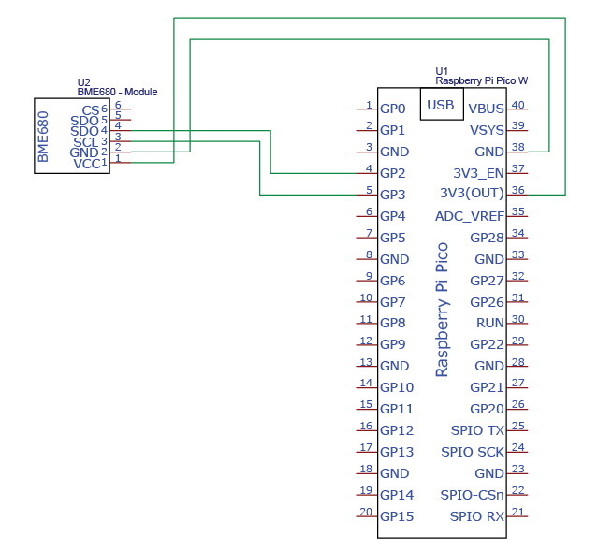
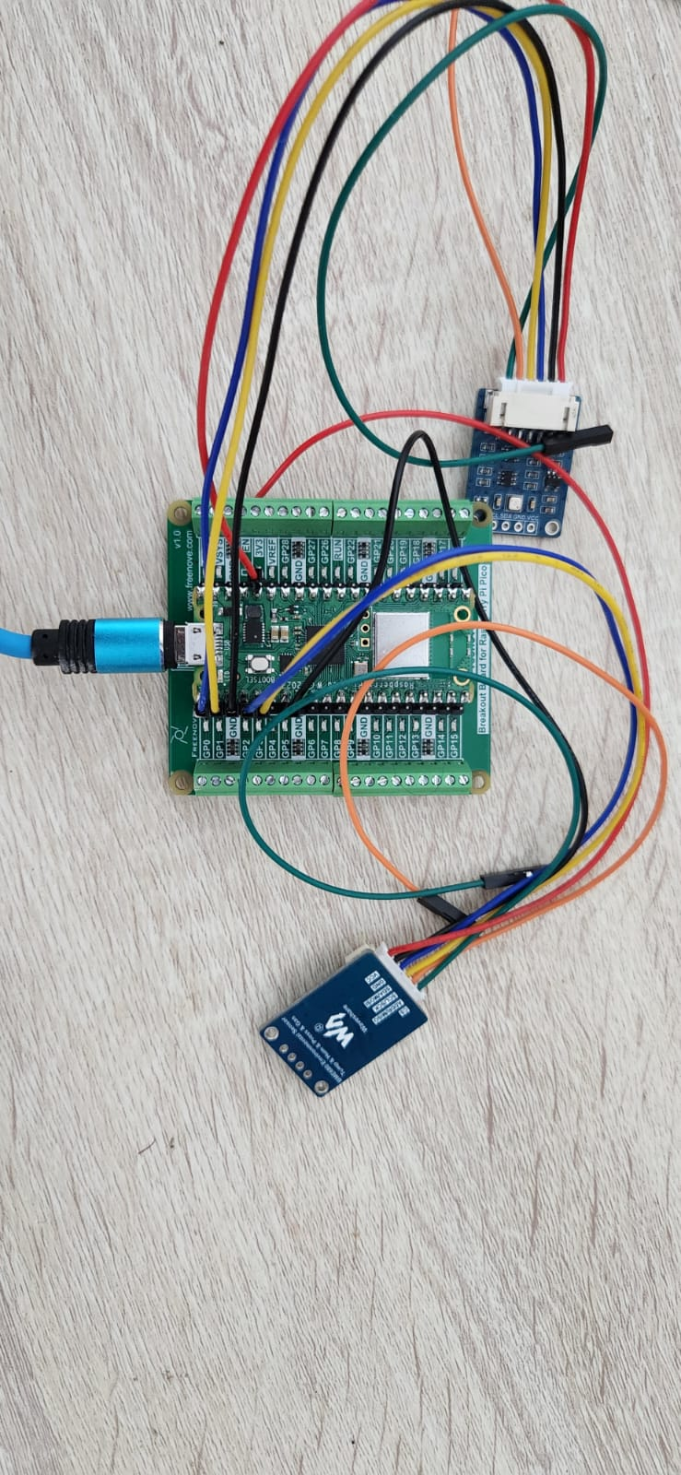
Circuit Connections:-

Slide 11
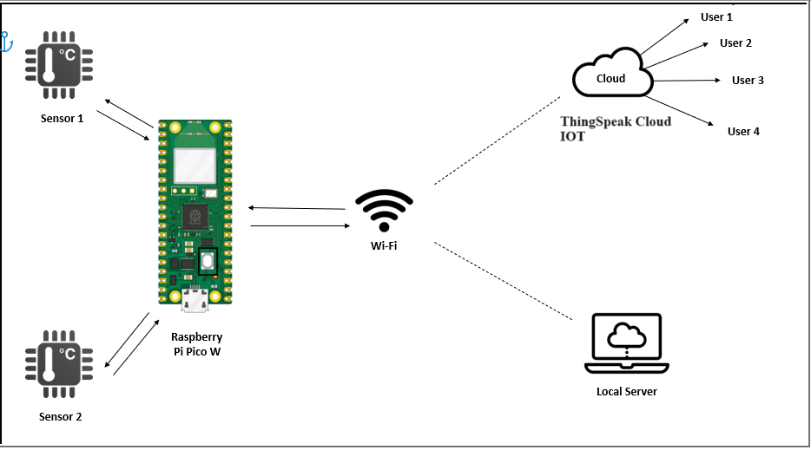
Architecture :-

Slide 12
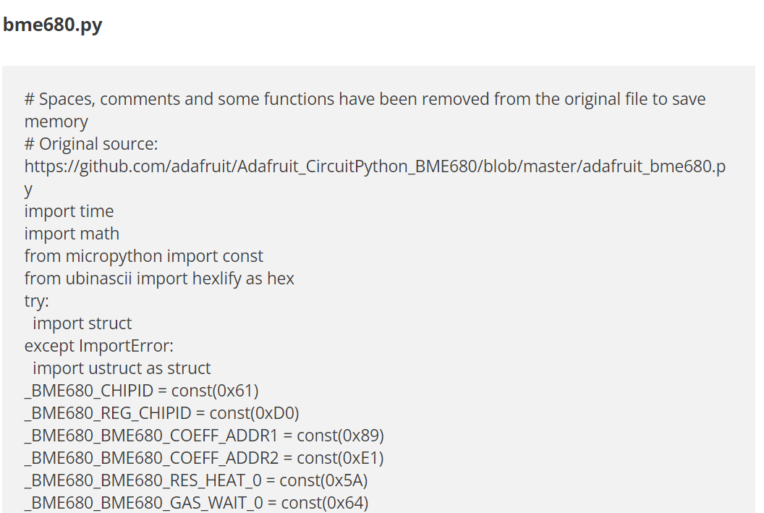
BME680 :-
BME680 MicroPython Library :
For this project we will require the MicroPython
BME680 library.

Slide 13
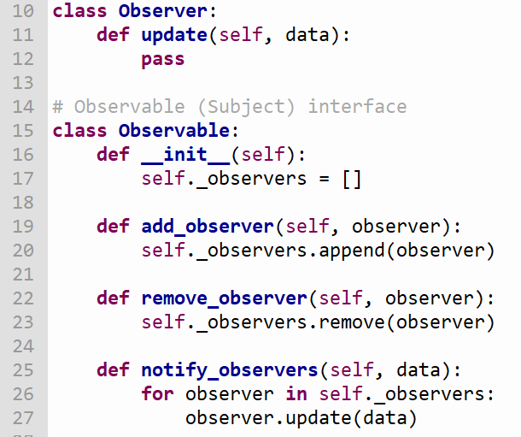
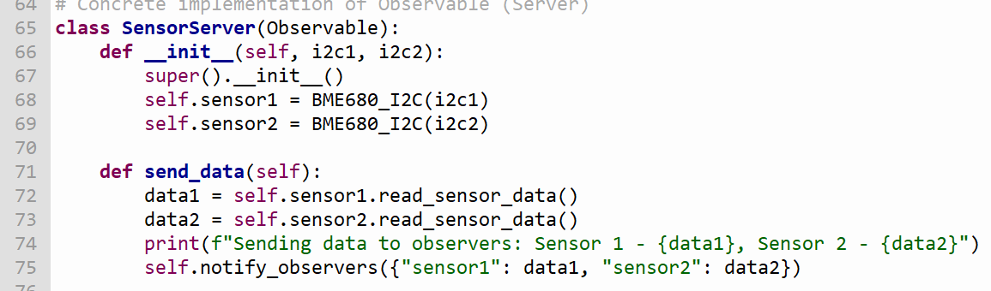
Design Pattern
Observer Design Pattern :
Observer Interface : The Observer class is an interface that declares the update method. This method is called by the observable when its state changes.
Observable Interface: The Observable class is another interface that defines the methods for managing a list of observers (add_observer, remove_observer, notify_observers).
Observable Implementation: The SensorServer class, representing the server that collects data from sensors, extends the Observable class.

Slide 14
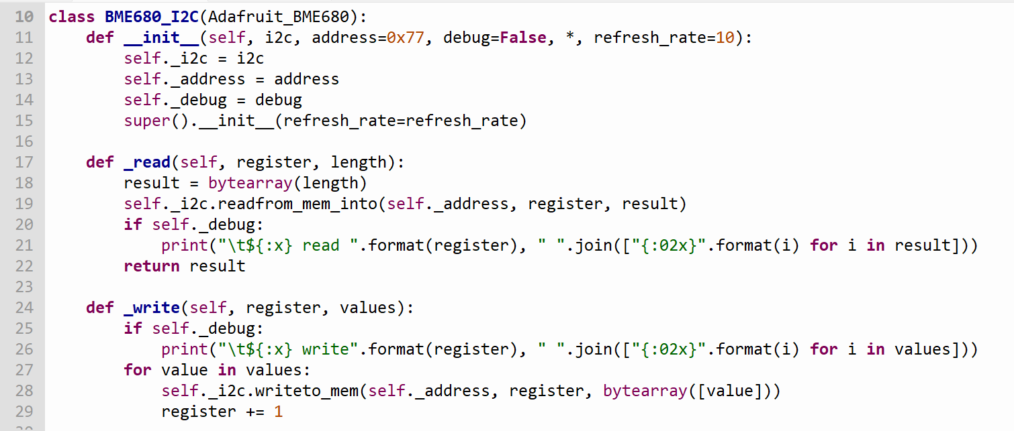
Code Review :-
BME680_I2C is initialized with I2C, sensor address, debug mode, and refresh rate.
Custom _read and _write methods handle I2C communication.
Two instances (bme1, bme2) are created for two BME680 sensors.
Each instance is associated with a specific I2C interface.

Slide 15
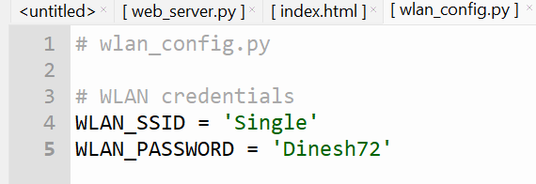
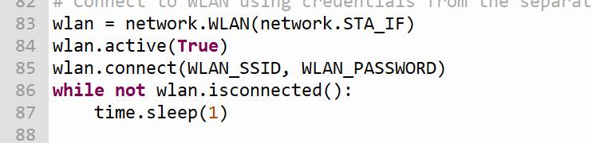
Wlan Connection :
WLAN credentials (SSID and password) are stored in a separate configuration file (wlan_config.py), isolating sensitive information from the main codebase.
Ensure that this configuration file is stored in a secure location that is not accessible by unauthorized users.
If the configuration file needs to be transmitted over a network, ensure that the transmission is secured using encryption (e.g., HTTPS).

Slide 16
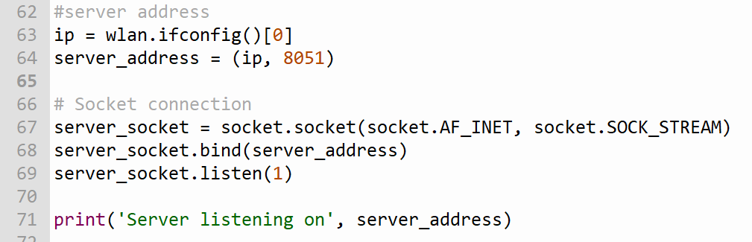
Server initialization
Dynamic Server Address Determination:
The device's IP address is dynamically obtained using wlan.ifconfig()[0].
This ensures the server address reflects the current IP assigned by the network.
A server address tuple is created with the dynamic IP and a predefined port
Socket Binding and Listening:
A socket is created using socket.socket(socket.AF_INET, socket.SOCK_STREAM) for IPv4 and TCP.
The server socket is bound to the specified address using server_socket.bind(server_address).
The address includes the dynamic IP and the predefined port
The server socket is set to listen for incoming connections with server_socket.listen(1).

Slide 17
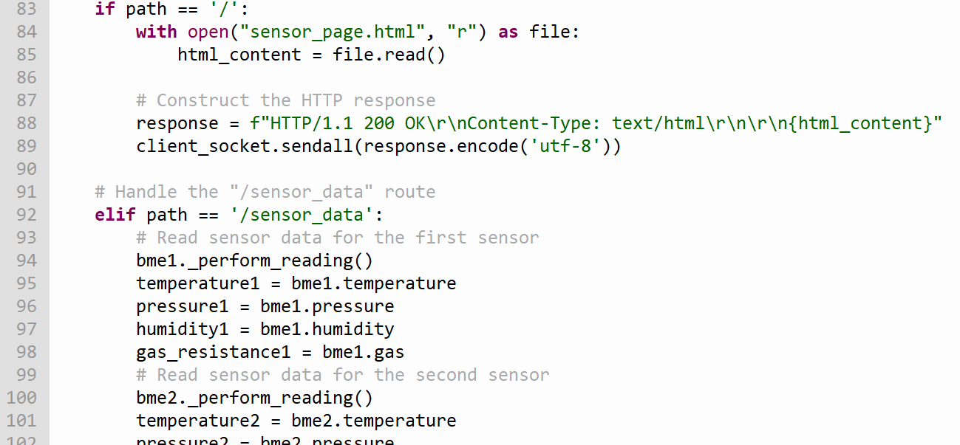
Handling Routes ("/" and "/sensor_data")
HTML Page Serving:
If the requested path is '/', the code reads the content of "sensor_page.html" and constructs an HTTP response.
The HTML content is sent as the response to the client.
Sensor Data Processing:
If the requested path is '/sensor_data', the code reads sensor data, calculates indices, and constructs a JSON response.
JSON Response:
The JSON response is constructed with an appropriate content type.
The response is sent to the client socket.

Slide 18
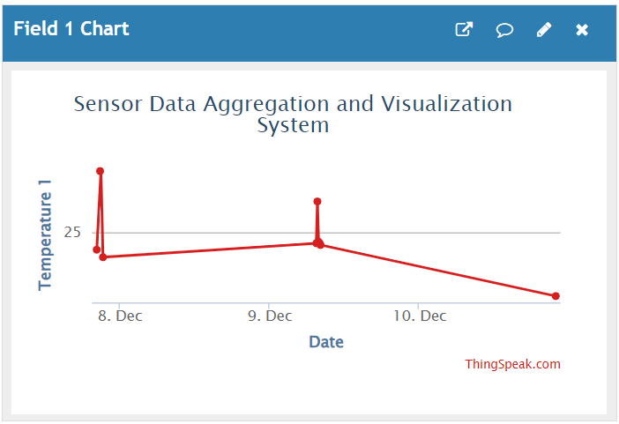
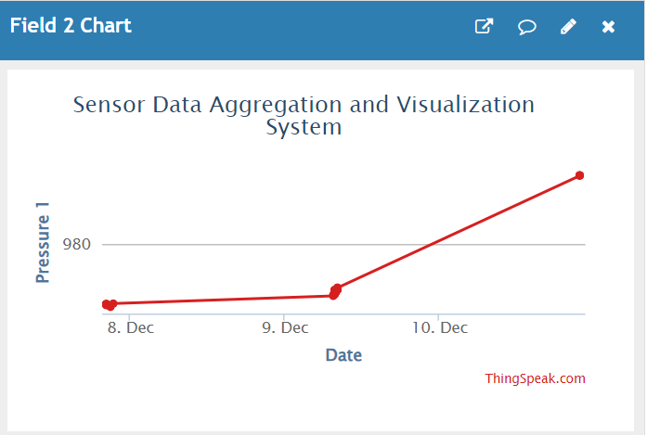
ThingSpeak for IOT
ThingSpeak is an IoT analytics platform that allows users to collect, analyze, and visualize data from sensors or devices.
The script uses a ThingSpeak API key (THINGSPEAK_API_KEY) and a channel ID (THINGSPEAK_CHANNEL_ID) for authentication when sending data to ThingSpeak.
Data is sent to ThingSpeak using HTTP GET requests. The script constructs a URL with sensor data fields and performs a GET request to update the ThingSpeak channel.
ThingSpeak simplifies the integration of IoT devices by providing an easy-to-use platform for data storage and visualization. The script demonstrates how sensor data can be seamlessly integrated with ThingSpeak.

Slide 19
Non functional requirements
Performance :-
Efficient Sensor Readings: The code aims to efficiently read sensor data by performing readings at a specified refresh rate (refresh_rate=10 seconds by default).
Optimized I2C Communication: The I2C communication with sensors is configured with a specified frequency (freq=100000) to optimize data transfer performance.
Reliability :-
Observer Design Pattern: The code implements the Observer design pattern to create a reliable and loosely coupled architecture for handling sensor data. This pattern enhances the flexibility and maintainability of the system.
Dynamic Sensor Data Loading: Sensor data is read dynamically during runtime, allowing for reliable and up-to-date information without the need for constant code modifications.
Handling WLAN Connection: The code includes a loop that waits until a WLAN connection is established (while not wlan.isconnected():). This ensures that the server is connected to the WLAN before proceeding.

Slide 20
Maintainability:
Changes in one component (e.g., the BME680_I2C sensor implementation) don't require modifications in other components (e.g., the SensorServer).
The code has a modular structure with clear separation of classes and functionalities. This facilitates code maintenance and future enhancements.
WLAN configuration and sensor addresses are stored in separate files, making it easy to update and maintain these configurations without modifying the main code.
Scalability:
Adding or removing sensors becomes easier without modifying the SensorServer code. New sensors can be added by creating instances of the BME680_I2C class and registering them as observers without affecting the existing code.
The Observer pattern makes it straightforward to scale the system by accommodating additional sensors.

Slide 21
Usability:
The code follows good software engineering principles by separating concerns using classes and interfaces. This separation enhances code readability, maintainability, and usability.
The code handles HTTP responses for both the root path ("/") and the "/sensor_data" route, providing different types of data (HTML content and JSON) based on the request path.
Security:
Isolation of WLAN Credentials: WLAN credentials (SSID and password) are stored in a separate configuration file (wlan_config.py), enhancing security by isolating sensitive information from the main codebase.
from wlan_config import WLAN_SSID, WLAN_PASSWORD
Secure Socket Connection: The server establishes a socket connection using TCP/IP, and the code provides basic security measures such as binding to a specific IP address and port.

Slide 22
Testing
Environmental Testing: Assessing hardware resilience to environmental factors (temperature, humidity, etc.). like we tested sensors temperature, pressure and humidity at different situations.
Functional Testing: Verified individual hardware components (e.g., sensors, devices) perform as intended and checking values at a time in different devices when we turned on server.
Interface Testing: Tested interfaces between software modules and hardware components, tested html code correctly integrated with pico.
Unit Testing: written test cases for testing functionality of code, checking expected values as per design
Performance Testing: Tested server values in multiple devices to ensure data correctness using wifi connection.

Slide 23
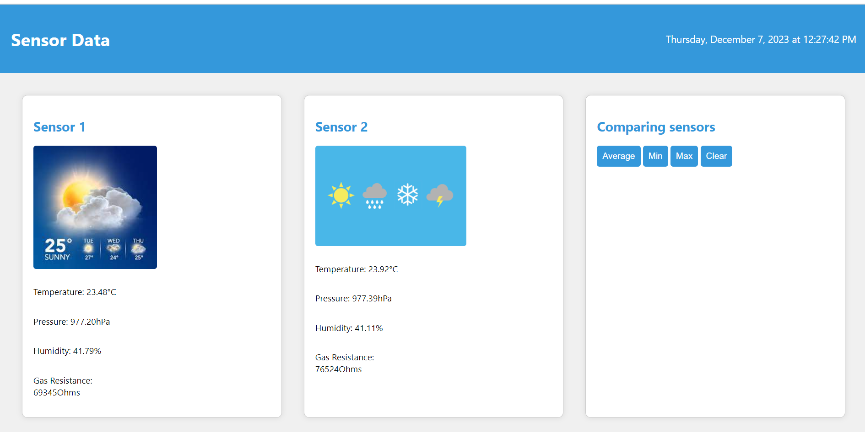
Client Server Page :-

Slide 24
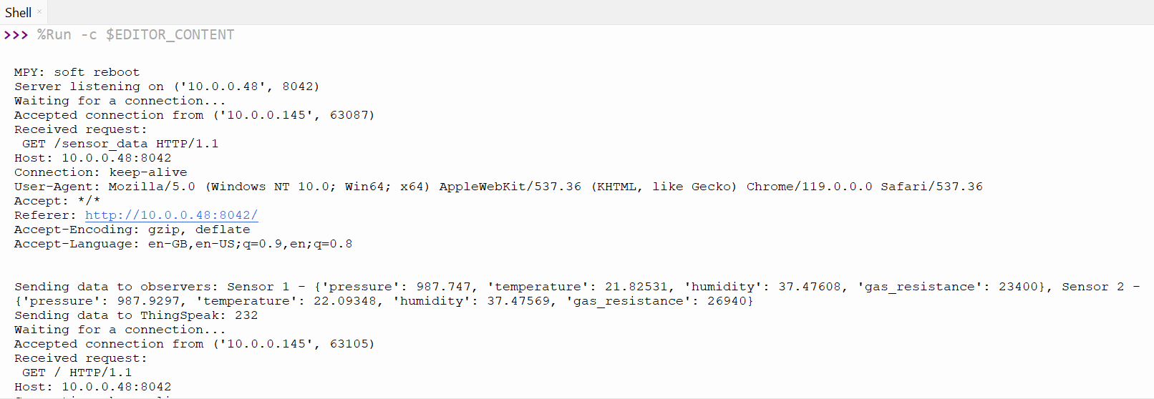
Results:

Slide 25
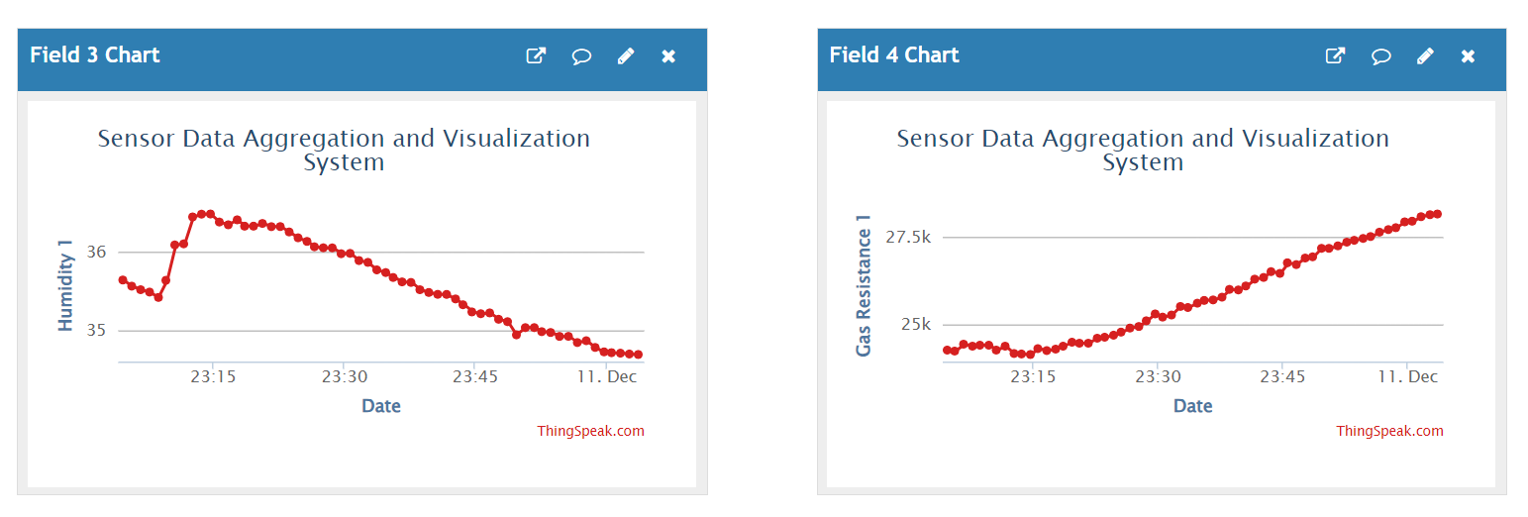
Results:

Slide 26
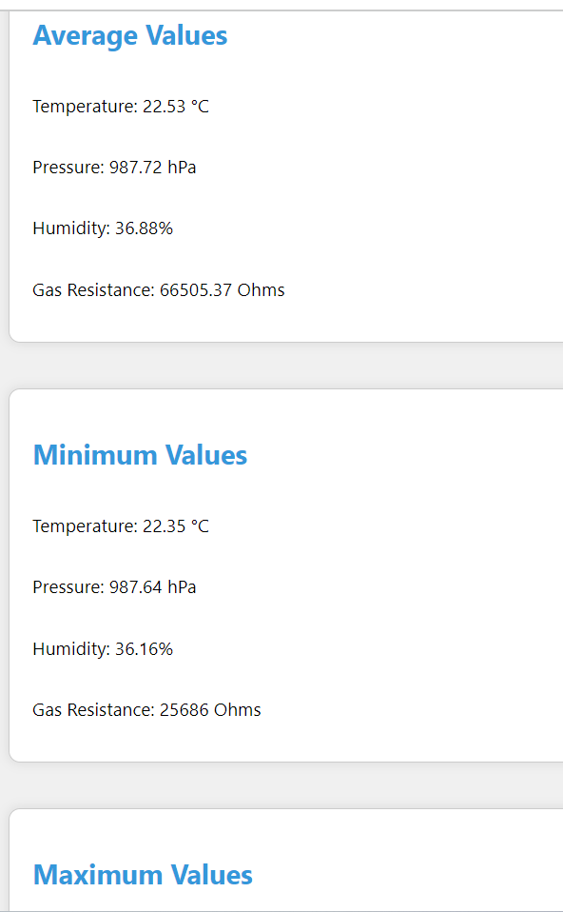
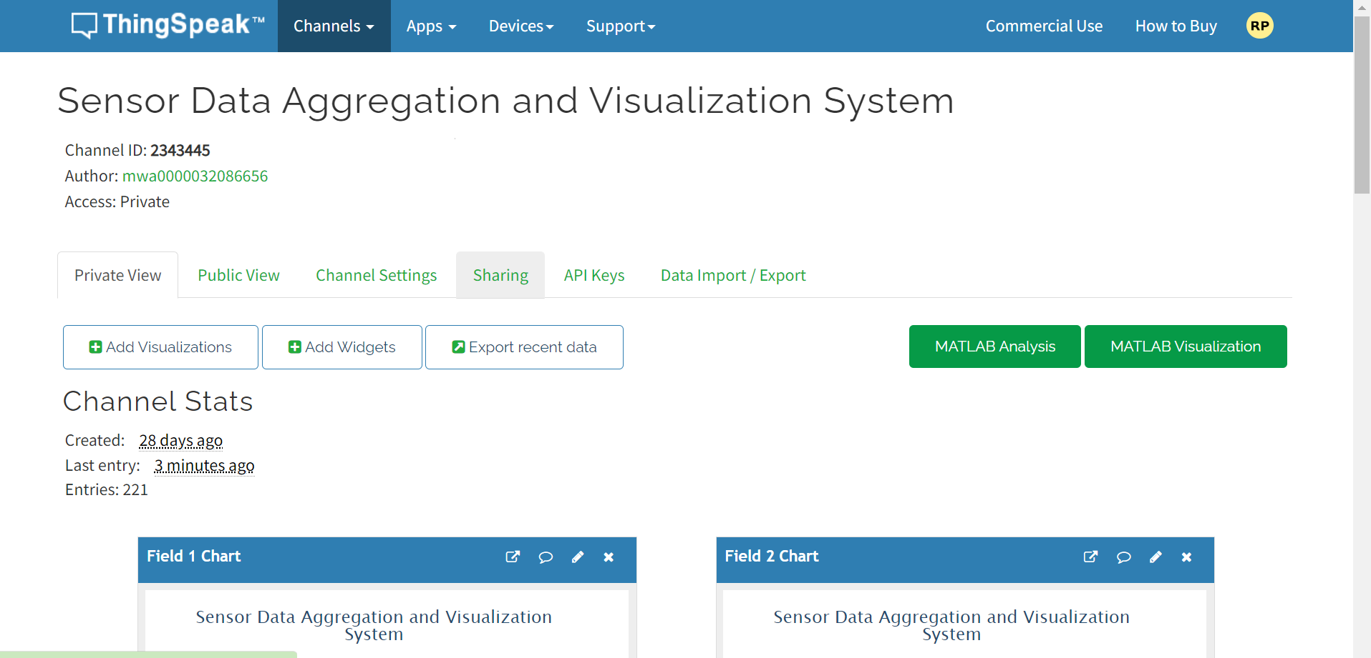
Results:

Slide 27
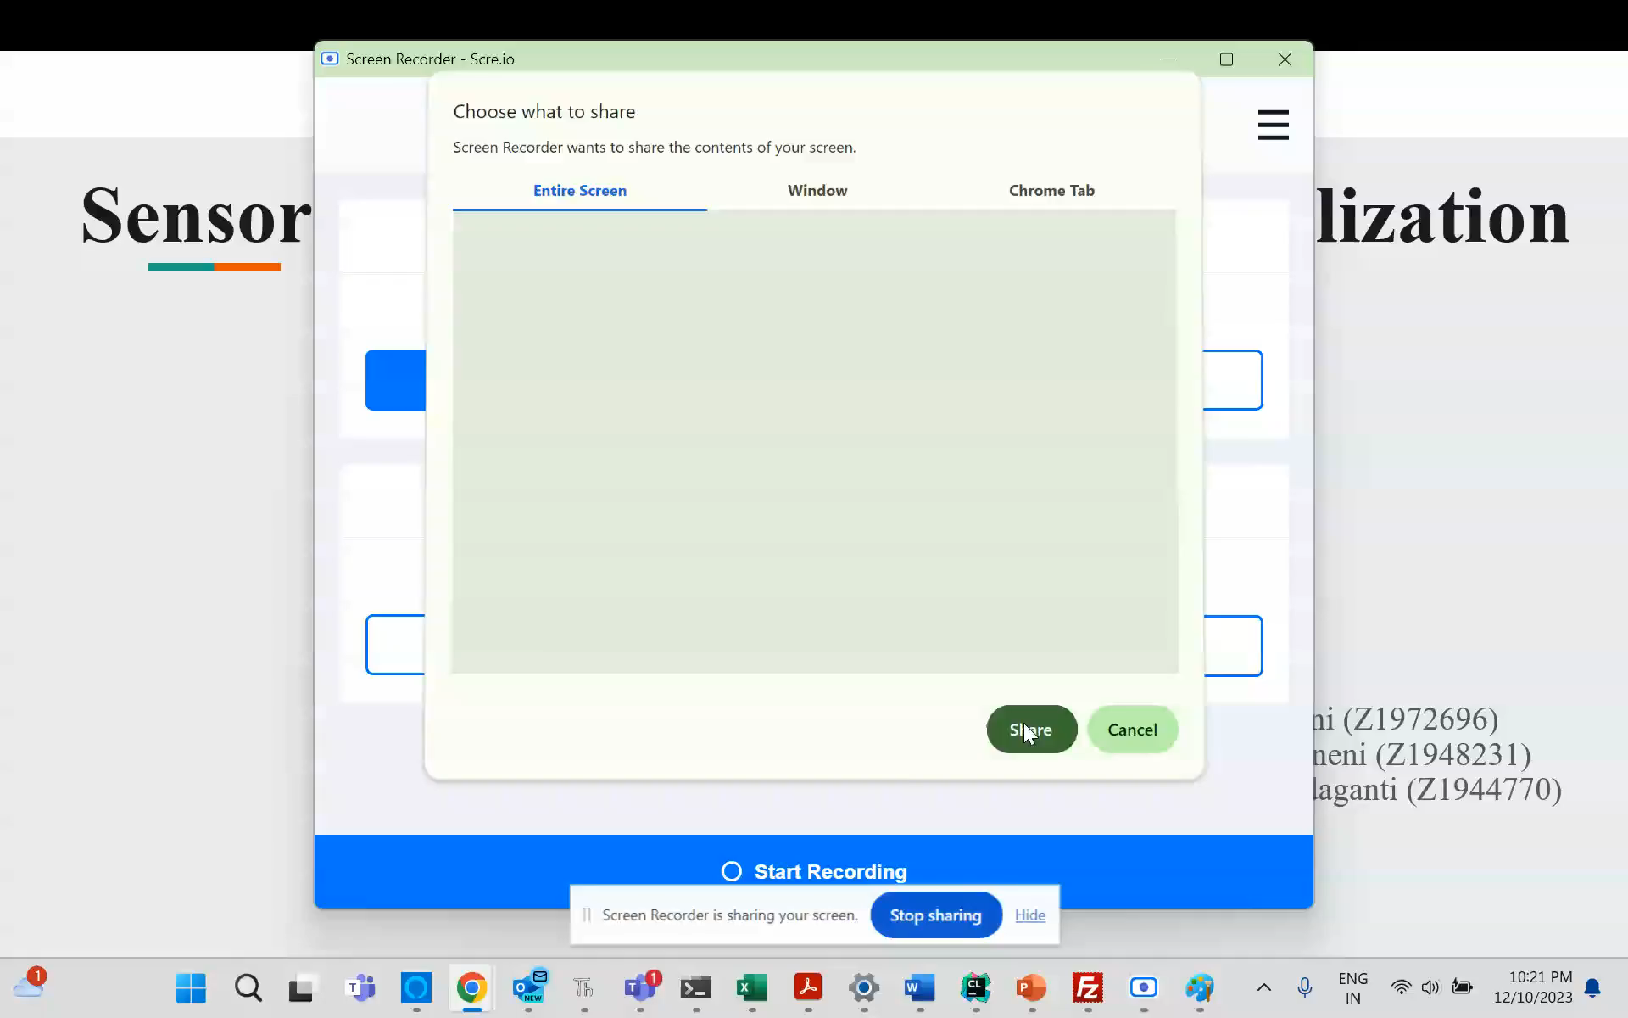
Demo

Slide 28
Thank You

